Slide 1
Machine Learning 02- Mathematics for Machine Learning
Dr. Malak Abdullah
Computer Science Department
Jordan University of Science and Technology

Slide 2
“What is the use of Mathematics for Machine Learning when we have computers to do it all?”.
Aspiring Machine Learning Engineers often tend to ask “What is the use of Mathematics for Machine Learning when we have computers to do it all?”. Well, that is true. Our computers have become capable enough to do the math in split seconds where we would take minutes or hours to perform the calculations. But in reality, it’s not the ability to solve the math. Rather, it is the eye of how the math needs to be applied.

Slide 3
“What is the use of Mathematics for Machine Learning when we have computers to do it all?”.
You need to analyze the data and infer information so that you can create a model that learns from the data. Math can help you in so many ways that it becomes mind-boggling that someone could hate this subject. Of course, doing math by hand is something I hate too but knowing how I use math is enough to explain my love for math.
Allow me to extend this love to you guys too because I won’t be teaching you just the Mathematics for Machine Learning but the various applications you can use it for, in real life!

Slide 4
Linear ALGEBRA

Slide 5
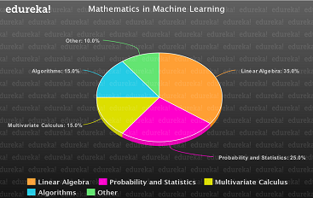
Why Linear Algebra?
The chart below will help you understand rather easily that Linear Algebra is used most widely when it comes to Machine Learning. It covers so many aspects making it unavoidable if you want to learn Mathematics for Machine Learning.

Slide 6
Why Linear Algebra?
Linear Algebra helps you in optimizing data, operations that can be performed on pixels such as shearing, rotation and much more. You can understand why Linear Algebra is such an important aspect when it comes to Mathematics for Machine Learning.
Let’s start off with the Mathematics for Machine Learning now and understand as much as we can. Remember that no one can master anything in a go. It takes time, patience and real-world experiences to help you master math but this lecture will for sure help you out with the basics!

Slide 7
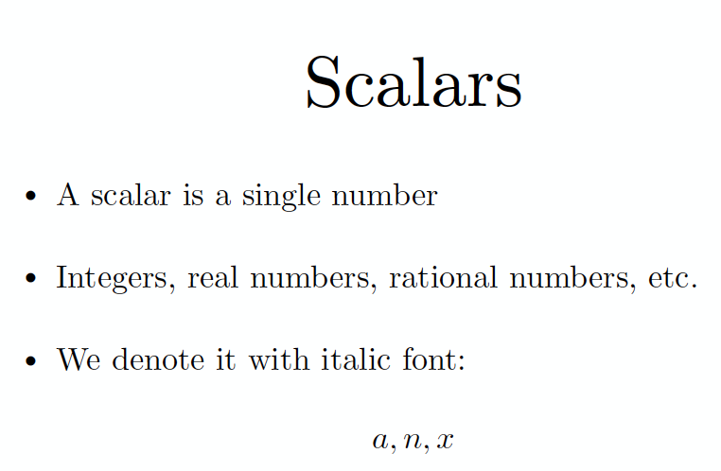

Slide 8
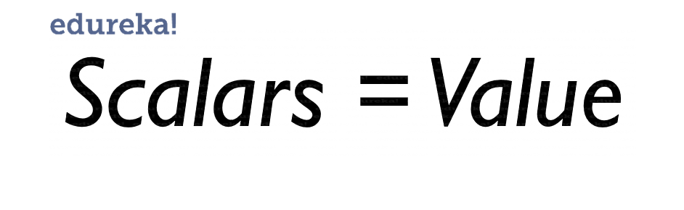
Scalar
What do we understand by a scalar? To put it in simple words, Scalars are just values that represent something. It can be something like the size of a house to temperature in an engine, scalars help us represent them and their values. So the math in scalars? Just simple Arithmetic.

Slide 9
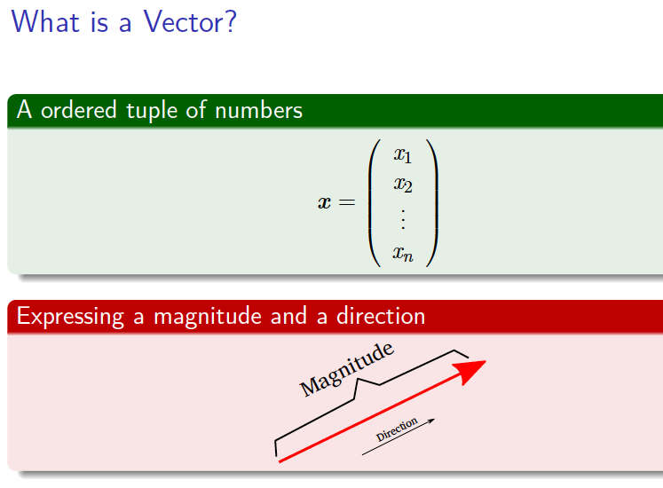
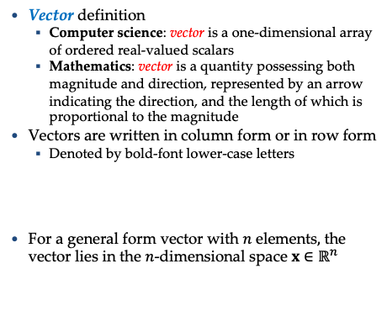
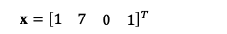
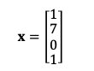
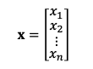
Vectors
Vector definition
Computer science: vector is a one-dimensional array of ordered real-valued scalars
Mathematics: vector is a quantity possessing both magnitude and direction, represented by an arrow indicating the direction, and the length of which is proportional to the magnitude
Vectors are written in column form or in row form
Denoted by bold-font lower-case letters
For a general form vector with $n$ elements$,$ the vector lies in the $n$-dimensional space ${x∈ℝ}^{n}$
$x=\left[\begin{matrix}1 \\ \begin{matrix}7 \\ 0\end{matrix} \\ 1\end{matrix}\right]$
$x={\left[\begin{matrix}1 & 7 & \begin{matrix}0 & 1\end{matrix}\end{matrix}\right]}^{T}$
$x=\left[\begin{matrix}x_{1} \\ \begin{matrix}x_{2} \\ ⋮\end{matrix} \\ x_{n}\end{matrix}\right]$

Slide 10
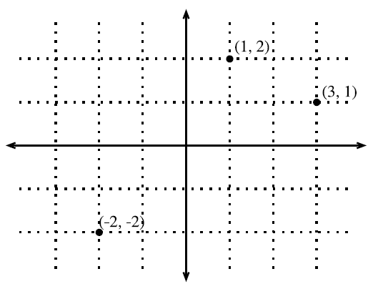
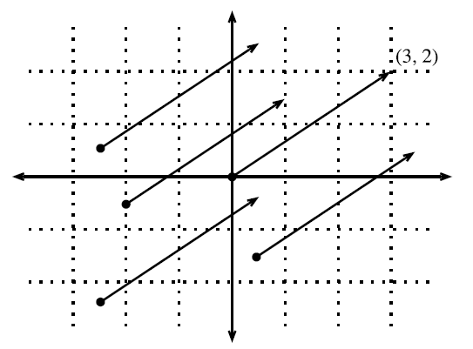
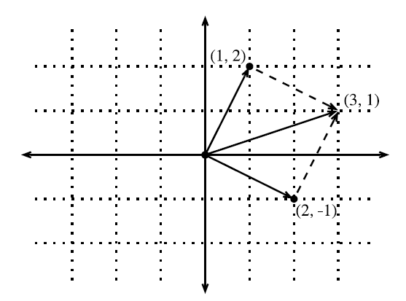
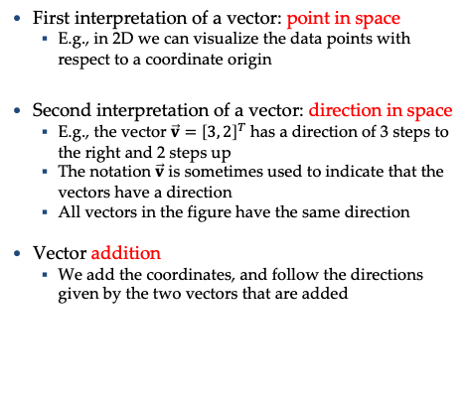
Geometry of Vectors
First interpretation of a vector: point in space
E.g., in 2D we can visualize the data points with respect to a coordinate origin
Second interpretation of a vector: direction in space
E.g., the vector $\vec{v}={\left[3, 2\right]}^{T}$ has a direction of 3 steps to the right and 2 steps up
The notation $\vec{v}$ is sometimes used to indicate that the vectors have a direction
All vectors in the figure have the same direction
Vector addition
We add the coordinates, and follow the directions given by the two vectors that are added
Picture from: http://d2l.ai/chapter_appendix-mathematics-for-deep-learning/geometry-linear-algebraic-ops.html#geometry-of-vectors

Slide 11
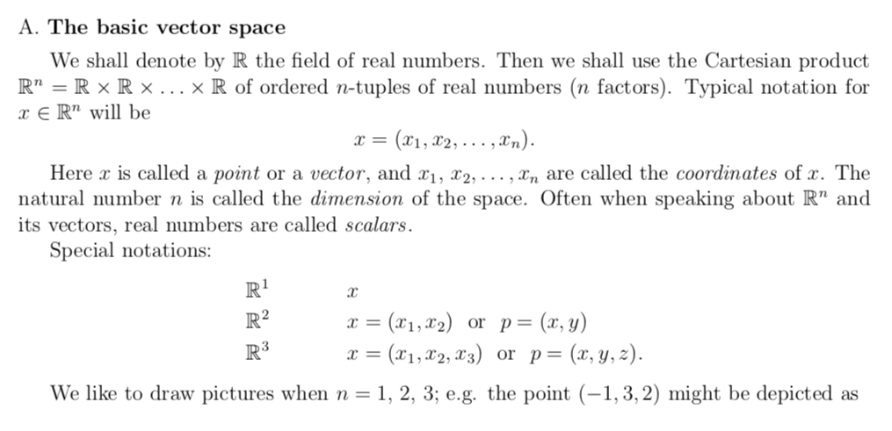
Vectors Basics

Slide 12
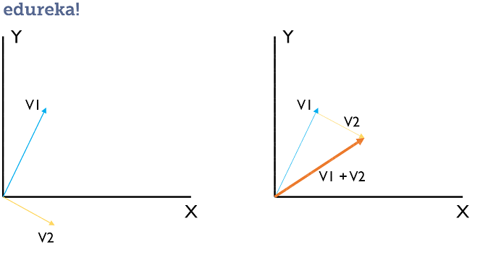
Vectors Basics
Vector Addition (Dot Product)
You can see that we had 2 vectors V1 and V2 and to add them, add their effect together. For example, if V1 has values [1, 2] and V2 has values [1, -1] for the X and Y axis respectively, the effective V1+V2 will have the value [2, 1] which is to add the scalar values of the Vectors. This is also called as the Dot Product.
The Equation for Dot Product is ^A.^B = a1+b1, a2+b2, …

Slide 13
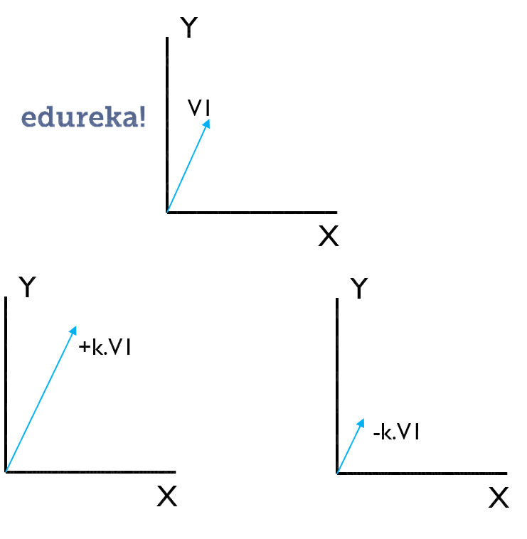
Scalar Multiplication
If a Vector is multiplied with a constant, it either grows or shrinks accordingly. This can be used in something called as Shearing which helps in the manipulation of pixel information.
The Equation for Scalar Multiplication is +k.^A or -k.^A = ^A’
The below diagrams will help you understand how this works.

Slide 14
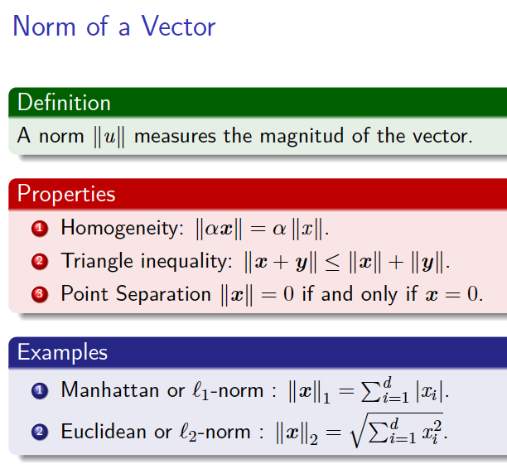
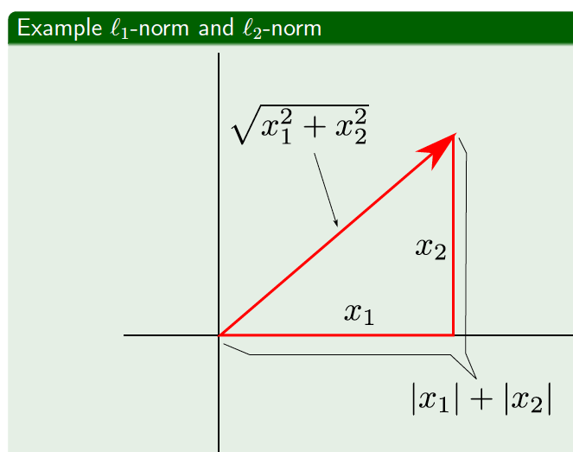
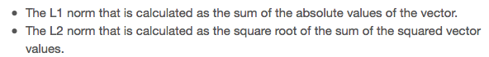
Norm

Slide 15
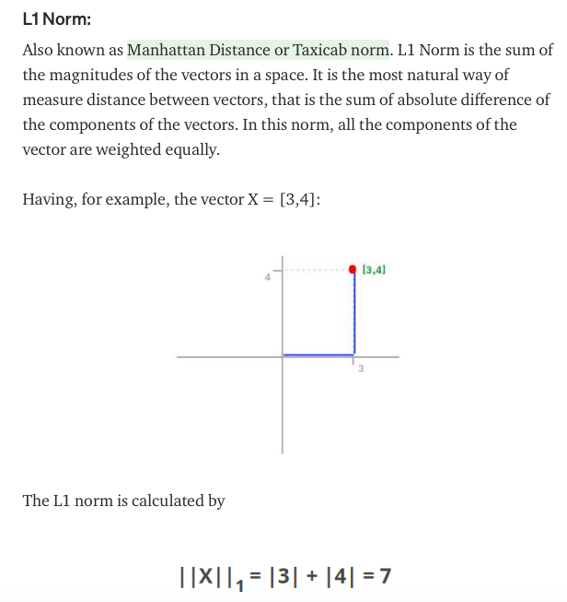
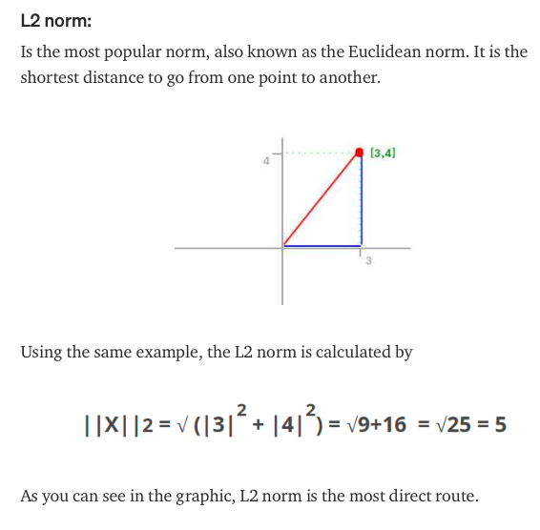

Slide 16
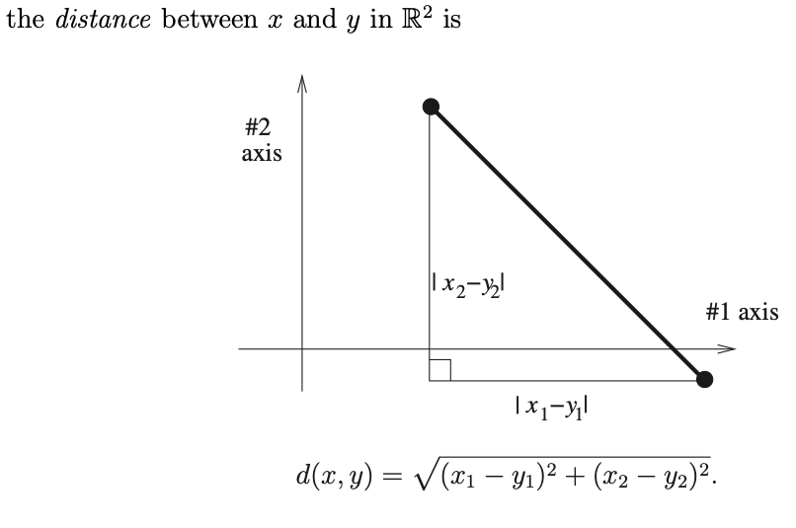
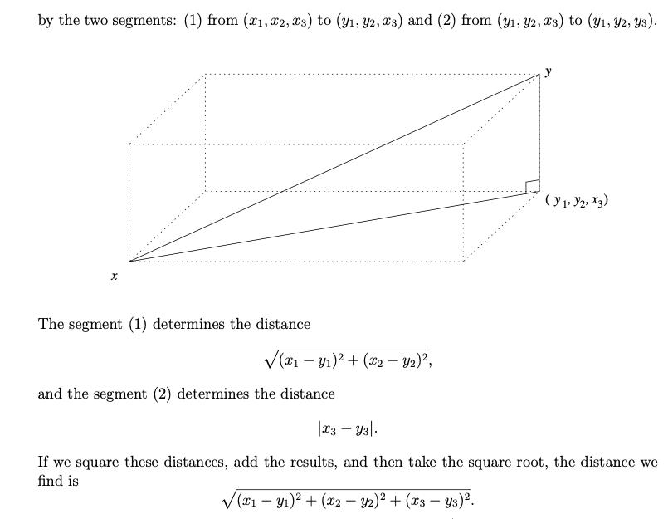
Distance between two points

Slide 17
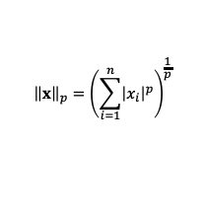
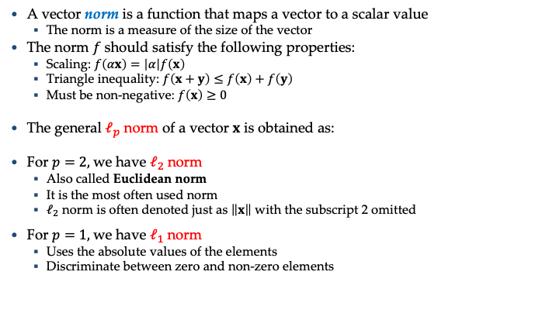
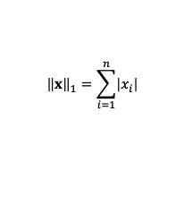
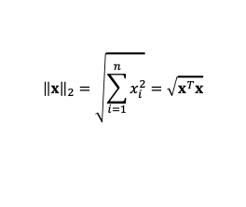
Norm of a Vector
A vector norm is a function that maps a vector to a scalar value
The norm is a measure of the size of the vector
The norm $f$ should satisfy the following properties:
Scaling: $f\left(αx\right)=\left|α\right|f\left(x\right)$
Triangle inequality: $f\left(x+y\right)≤f\left(x\right)+f\left(y\right)$
Must be non-negative: $f\left(x\right)≥0$
The general $ℓ_{p}$ norm of a vector $x$ is obtained as:
For $p=2,$we have $ℓ_{2}$ norm
Also called Euclidean norm
It is the most often used norm
$ℓ_{2}$ norm is often denoted just as $\left\|x\right\|$ with the subscript 2 omitted
For $p=1,$we have $ℓ_{1}$ norm
Uses the absolute values of the elements
Discriminate between zero and non-zero elements
$${\left\|x\right\|}_{p}={\left(\sum_{i=1}^{n}{{\left|x_{i}\right|}^{p}}\right)}^{\frac{1}{p}}$$
$${\left\|x\right\|}_{2}=\sqrt{\sum_{i=1}^{n}{x_{i}^{2}}}=\sqrt{x^{T}x}$$
$${\left\|x\right\|}_{1}=\sum_{i=1}^{n}{\left|x_{i}\right|}$$

Slide 18
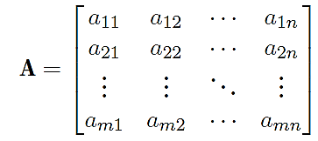
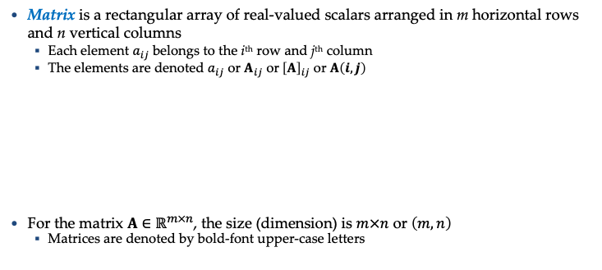
Matrices
Matrix is a rectangular array of real-valued scalars arranged in m horizontal rows and n vertical columns
Each element $a_{ij}$ belongs to the i^{th} row and j^{th} column
The elements are denoted $a_{ij}$ or $A_{ij}$ or${ \left[A\right]}_{ij}$ or $A\left(i,j\right)$
For the matrix $A∈ℝ^{m×n}$, the size (dimension) is $m×n$ or $\left(m,n\right)$
Matrices are denoted by bold-font upper-case letters

Slide 19
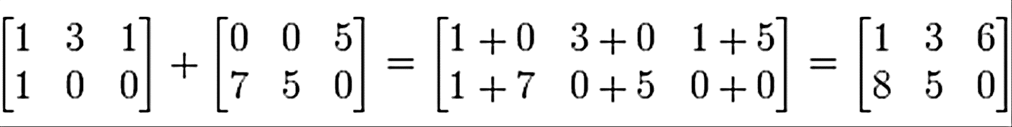
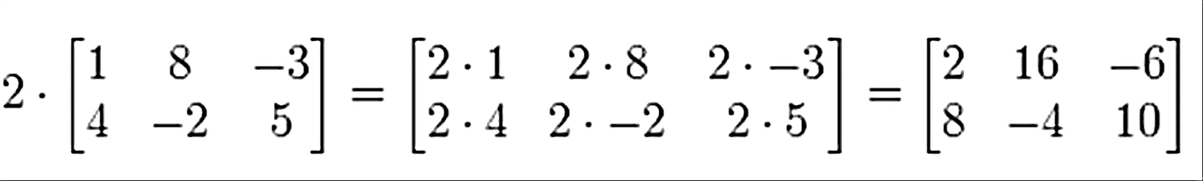
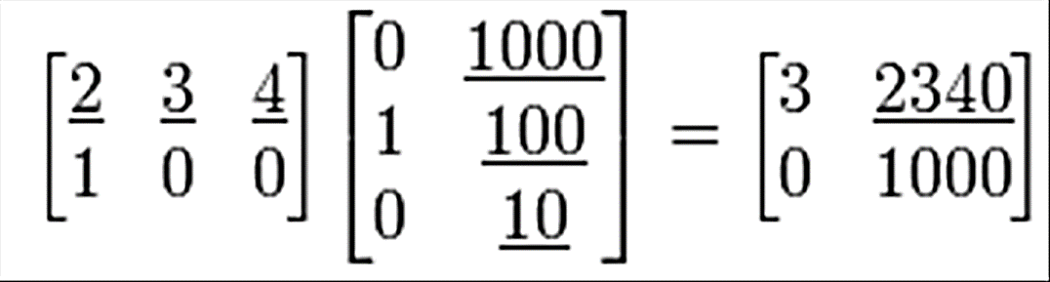
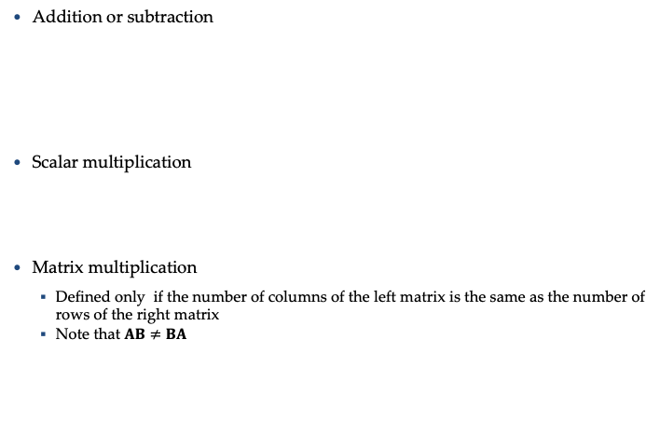
Matrices
Addition or subtraction
Scalar multiplication
Matrix multiplication
Defined only if the number of columns of the left matrix is the same as the number of rows of the right matrix
Note that $AB≠BA$

Slide 20
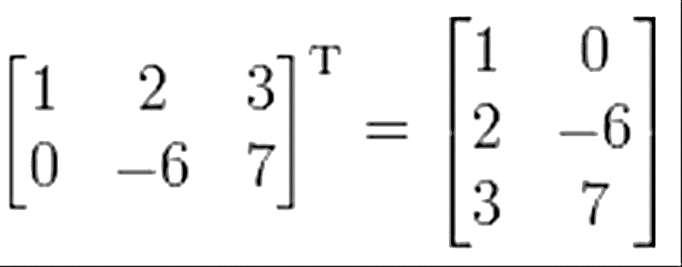
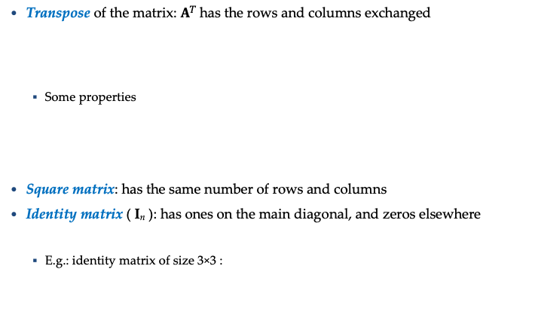
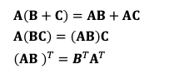
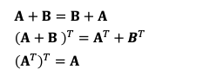
Matrices
Transpose of the matrix: $A^{T}$has the rows and columns exchanged
Some properties
Square matrix: has the same number of rows and columns
Identity matrix ( I_{n} ): has ones on the main diagonal, and zeros elsewhere
E.g.: identity matrix of size 3×3 :
$$A+B=B+A$$
$${\left(A+B \right)}^{T}=A^{T}+B^{T}$$
$${\left(A^{T}\right)}^{T}=A$$
$$A\left(B+C\right)=AB+AC$$
$$A\left(BC\right)=\left(AB\right)C$$
$${\left(AB \right)}^{T}=B^{T}A^{T}$$

Slide 21
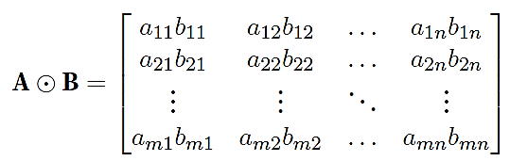
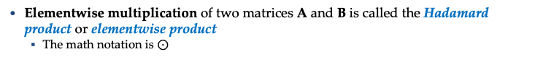
Matrices
Elementwise multiplication of two matrices A and B is called the Hadamard product or elementwise product
The math notation is $⊙$

Slide 22
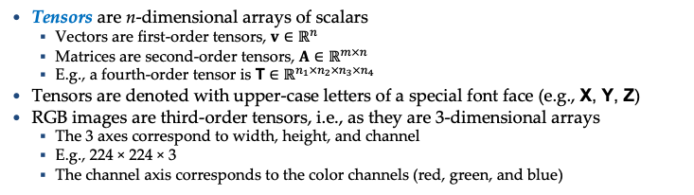
Tensors
Tensors are n-dimensional arrays of scalars
Vectors are first-order tensors, $v∈ℝ^{n}$
Matrices are second-order tensors, $A∈ℝ^{m×n}$
E.g., a fourth-order tensor is $\text{T}∈ℝ^{n_{1}×n_{2}×n_{3}×n_{4}}$
Tensors are denoted with upper-case letters of a special font face (e.g., $\text{X}\text{, }\text{Y}\text{, }\text{Z}$)
RGB images are third-order tensors, i.e., as they are 3-dimensional arrays
The 3 axes correspond to width, height, and channel
E.g., 224 × 224 × 3
The channel axis corresponds to the color channels (red, green, and blue)

Slide 23
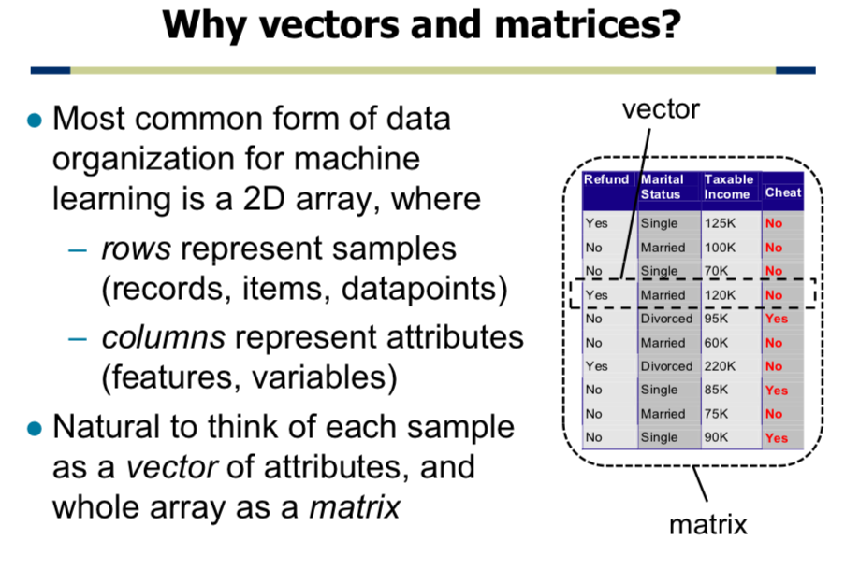

Slide 24

Numpy
NumPy is a library for the Python programming language, adding support for large, multi-dimensional arrays and matrices, along with a large collection of high-level mathematical functions to operate on these arrays
Numpy array creation
Array access and operations
Basic linear algebra

Slide 25
Numpy
Stands for Numerical Python an efficient multi-dimensional container for generic data
is the fundamental package required for high performance computing and data analysis
It provides
ndarray for creating multiple-dimensional arrays
Standard math functions for fast operations on entire arrays of data without having to write loops
Tools for reading/writing array data
Linear algebra tools
etc.

Slide 26
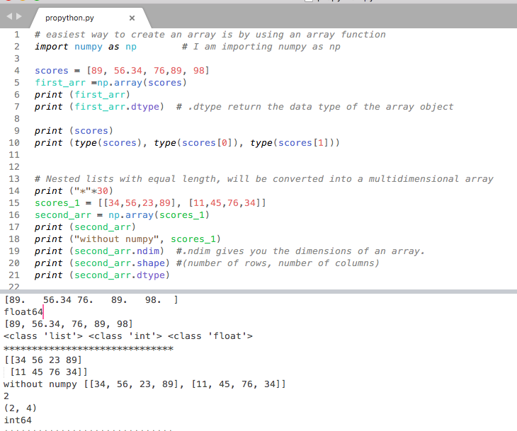

Slide 27
ndarray vs list of lists
gArray = np.array(examGrades)
In [5]: gArray[0,2]. # gArray[0][2]
Out[5]: 60
In [7]: gArray[2,:] #gArray[2]
Out[7]: array([99, 67, 84])
In [8]: gArray[:, 0]
Out[8]: array([79, 95, 99, 76, 91, 70, 88, 67, 82, 94])
In [9]: gArray[:3, :2]
Out[9]:
array([[79, 95],
[95, 60],
[99, 67]])
In [3]: gArray
Out[3]:
array([[79, 95, 60],
[95, 60, 61],
[99, 67, 84],
...,
[67, 73, 80],
[82, 89, 61],
[94, 67, 88]])

Slide 28
The N-dimensional array (ndarray)
The number of dimensions and items in an array is defined by its shape, which is a tuple of N non-negative integers that specify the sizes of each dimension.
The type of items in the array is specified by a separate data-type object (dtype), one of which is associated with each ndarray.
As with other container objects in Python, the contents of an ndarray can be accessed and modified by indexing or slicing the array (using, for example, N integers), and via the methods and attributes of the ndarray.
In [15]: type(gArray)
Out[15]: numpy.ndarray
In [16]: gArray.ndim
Out[16]: 2
In [17]: gArray.shape
Out[17]: (10, 3)
In [18]: gArray.dtype
Out[18]: dtype('int32')

Slide 29
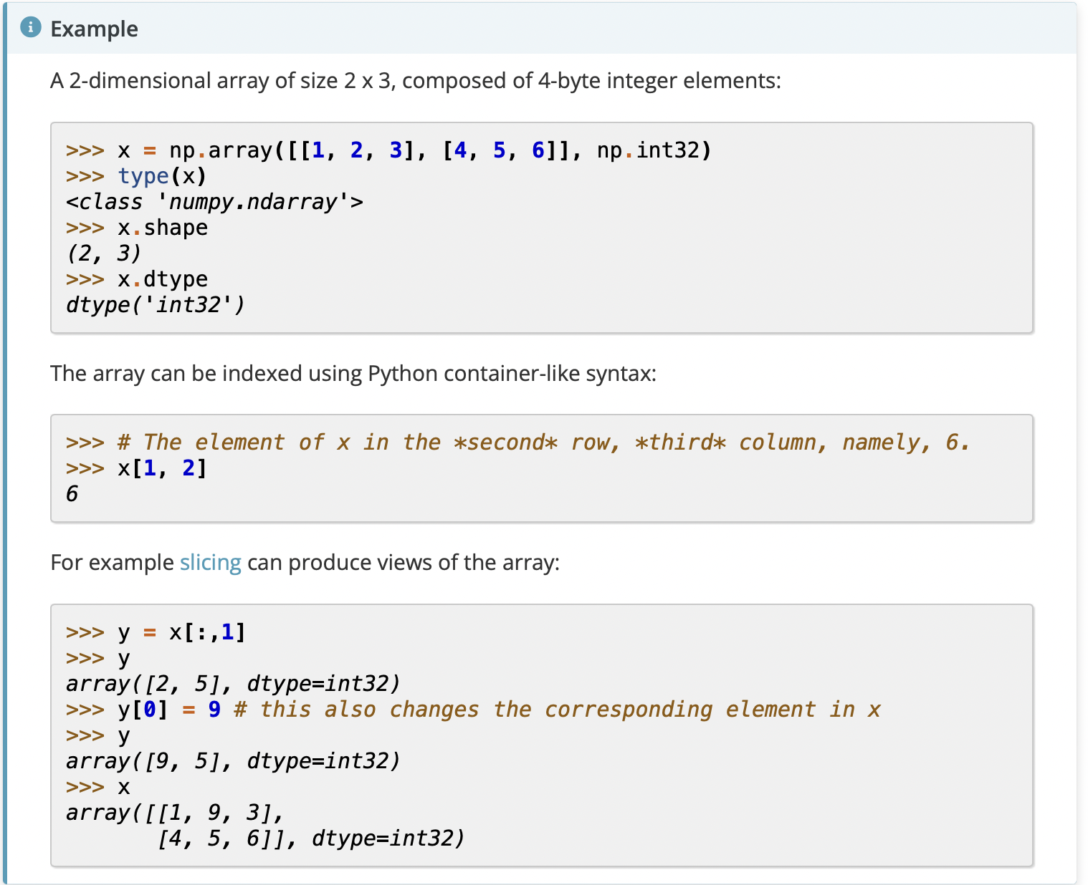

Slide 30
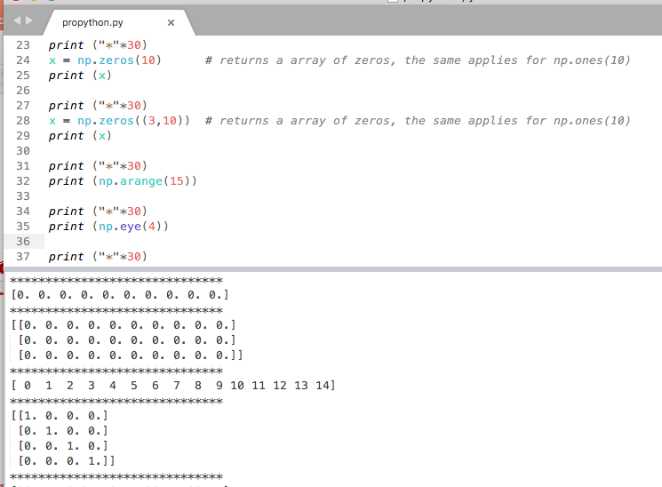
Examples

Slide 31
Creating ndarrays
In [69]: np.eye(3)
Out[69]:
array([[ 1., 0., 0.],
[ 0., 1., 0.],
[ 0., 0., 1.]])
In [70]: np.arange(0, 10, 2)
Out[70]: array([0, 2, 4, 6, 8])
np.array
np.zeros
np.ones
np.eye
np.arange
np.random
In [65]: np.array([[0,1,2],[2,3,4]])
Out[65]:
array([[0, 1, 2],
[2, 3, 4]])
In [66]: np.zeros((2,3))
Out[66]:
array([[ 0., 0., 0.],
[ 0., 0., 0.]])
In [67]: np.ones((2,3))
Out[67]:
array([[ 1., 1., 1.],
[ 1., 1., 1.]])
In [295]: np.random.randint(0, 10, (3,3))
Out[295]:
array([[8, 7, 6],
[0, 8, 9],
[9, 0, 4]])

Slide 32
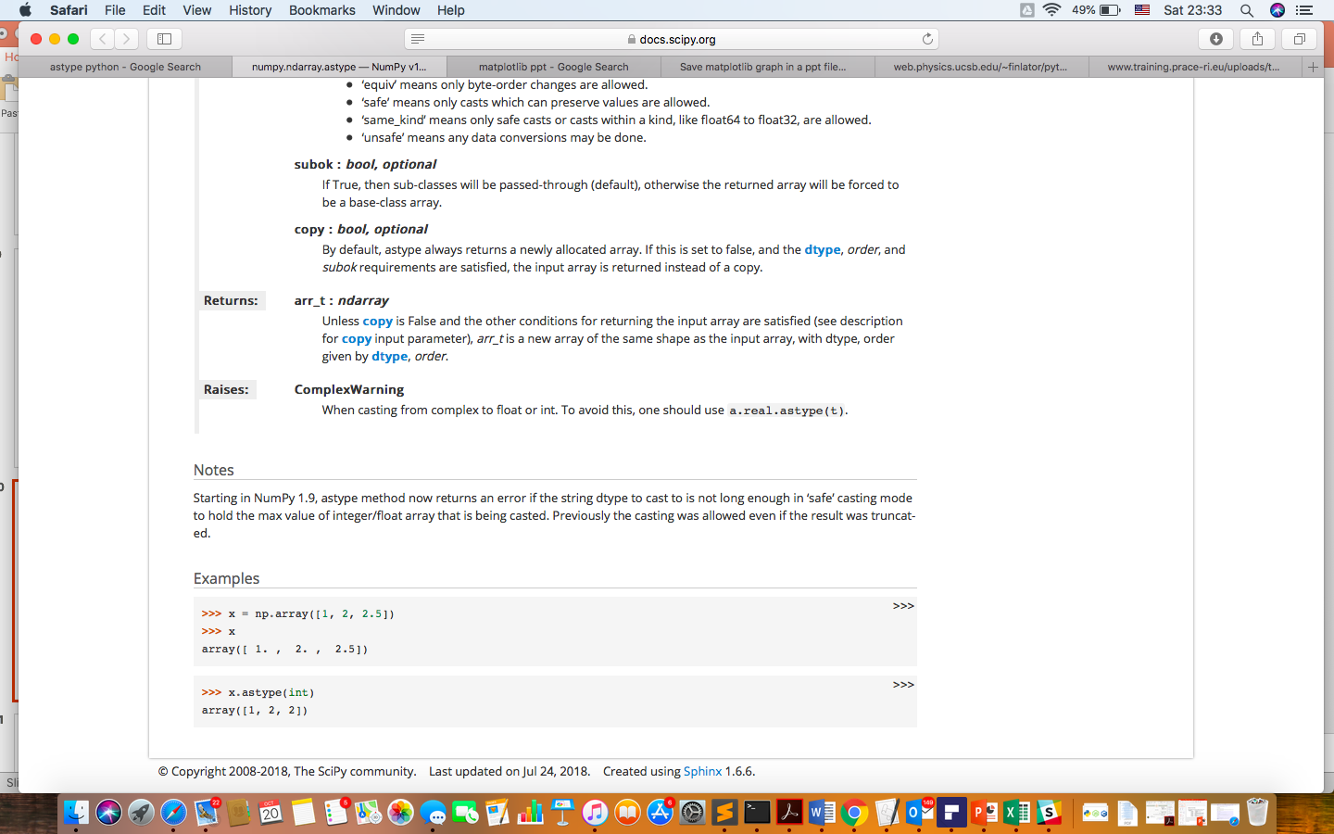
Numpy data types
int8, int16, int32, int64
float16, float32, float64, float128
bool
object
String
Unicode
gArray.astype
In [34]: gArray.astype(float64)
Out[34]:
array([[ 79., 95., 60.],
[ 95., 60., 61.],
...,
[ 82., 89., 61.],
[ 94., 67., 88.]])
64 bits
In [79]: num_string = array(['1.0', '2.05', '3'])
In [81]: num_string
Out[81]:
array(['1.0', '2.05', '3’], dtype='<U4')
In [82]: num_string.astype(float)
Out[82]: array([ 1. , 2.05, 3. ])

Slide 33
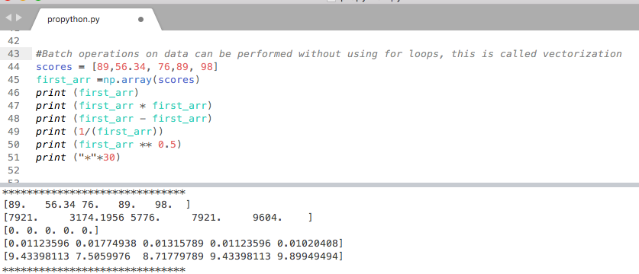
Examples

Slide 34
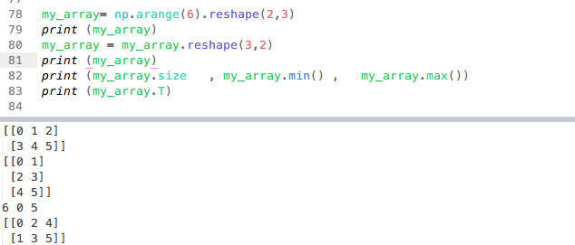
Reshape

Slide 35
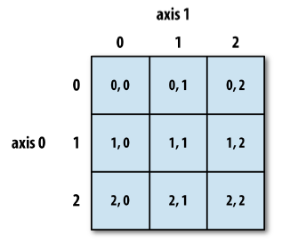
Reshaping and transposing
In [280]: In [77]: np.arange(6).reshape((2,3))
Out[280]:
array([[0, 1, 2],
[3, 4, 5]])
In [281]: In [77]: np.arange(6).reshape((2,3), order='F')
Out[281]:
array([[0, 2, 4],
[1, 3, 5]])
In [290]: np.arange(6).reshape(2,3).T
Out[290]:
array([[0, 3],
[1, 4],
[2, 5]])

Slide 36
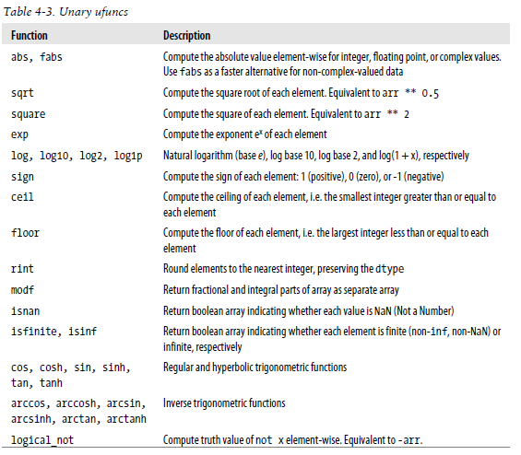
Fast element-wise functions
print (np.sqrt(my_array))

Slide 37
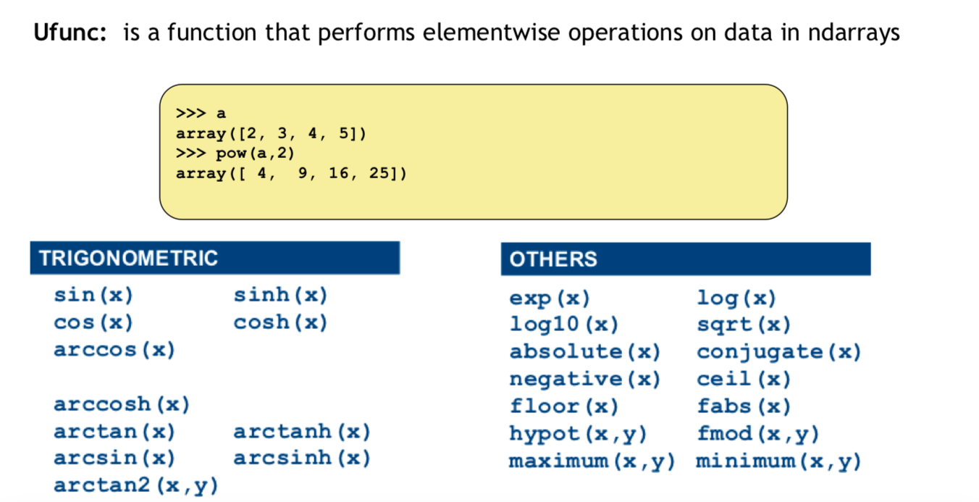

Slide 38
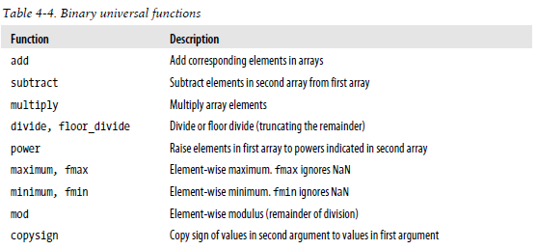

print (np.add(my_array,my_array))
https://docs.scipy.org/doc/numpy/reference/

Slide 39

Dot product
In [303]: a = b = np.arange(5)
In [305]: a
Out[305]: array([0, 1, 2, 3, 4])
In [306]: b
Out[306]: array([0, 1, 2, 3, 4])
In [307]: a.dot(b)
Out[307]: 30

Slide 40

More and more: https://numpy.org/doc/stable/reference/arrays.ndarray.html

Slide 41
Probability

Slide 42
What is Probability?
Probability in the simplest of explanations is the chance of something happening but in a quantified manner. Meaning that there is a number that is attached to something happening. When I say let’s flip a coin, there is an equal chance of it being either a head or a tail. So if we put this into numbers, there is a 50% chance that it could be either a head or a tail.
In the formal sense, “Probability is a measure of how likely an event will occur.” It can be written down as:
Probability = Event Desired / Total Outcomes

Slide 43
Example
Probability is the measure of how likely an event will occur. To be more precise probability is the ratio of desired outcomes to total outcomes:
(desired outcomes) / (total outcomes)
The probabilities of all outcomes always sums up to 1. Consider the famous rolling dice example:
On rolling a dice, you get 6 possible outcomes
Each possibility only has one outcome, so each has a probability of 1/6
For example, the probability of getting a number ‘2’ on the dice is 1/6

Slide 44
Probability review
Random Experiment: An experiment or a process for which the outcome cannot be predicted with certainty.
Sample space: The entire possible set of outcomes of a random experiment is the sample space of that experiment.
Event: One or more outcomes of an experiment is called an event. It is a subset of sample space. There are two types of events in probability:
Disjoint Event: Disjoint Events do not have any common outcomes. For example, a single card drawn from a deck cannot be a king and a queen
Joint Event: Non-Disjoint Events can have common outcomes. For example, a student can get 100 marks in statistics and 100 marks in probability

Slide 45
Probability review
Random Variable: A variable that takes on different values determined randomly.
• Example: The height of a person from the US.
• Distribution: The different values a random variable can take on along with the probability of that value.
• We talk about sampling from a distribution:
“Consider a sample of 100 different heights of people from the US drawn randomly from the distribution of all heights.”

Slide 46

Probability Spaces
Rolling a 6-sided dice: The number of possible outcomes = 6 The number of possible events = 2^6= 64
Example event:
to roll 1 or 6
to roll 1 or 2 or 6 …etc

Slide 47
Variables
The different types of variables. They are mainly of two types:
Discrete Variable: A variable that can only take on a certain finite value within a specific range is called a discrete variable. It usually separates the values by a finite interval, e.g., a sum of two dice. On rolling two dice and adding up the resulting outcome, the result can only belong to a set of numbers not exceeding 12 (as the maximum result of a dice throw is 6). The values are also definite.
Continuous Variable: A continuous random variable can take on infinite different values within a range of values, e.g., amount of rainfall occurring in a month. The rain observed can be 1.7cm, but the exact value is not known. It can, in actuality, be 1.701, 1.7687, etc. As such, you can only define the range of values it falls into. Within this value, it can take on infinite different values.

Slide 48


Slide 49


Slide 50

Distributions in Probability
For discrete variables, the probability is straightforward and can be calculated easily. But for continuous variables which can take on infinite values, the probability also takes on a range of infinite values.
Probability Distributions help us understand the kind of data we are working with, how they are distributed and differ from each other. Every aspect of the data can be understood, visualized using the Distributions.
For Machine Learning, we will only concentrate on 2 distributions:
Probability Density Function (PDF)
Normal Distribution

Slide 51


Probability Density Function (PDF)
The Probability Density Function (PDF) is concerned with the relative likelihood for a continuous random variable to take on a given value. The PDF gives the probability of a variable that lies between the range ‘a’ and ‘b’.
In the case of a continuous random variable, the probability taken by X on some given value x is always 0. In this case, if we find P(X = x), it does not work.

Slide 52

Normal Distribution
Normal distribution, otherwise known as the Gaussian distribution, is a probability distribution that denotes the symmetric property of the mean. The idea behind this function is that the data near the mean occurs more frequently than the data away from the mean. It infers that the data around the mean represents the entire data set.

Slide 53


Slide 54


Slide 55

Types Of Probability
Probability depends on the kind of application we are working with. There are basically 3 types of Probability that we have:
Marginal Probability means that an event will occur without any intervention or dependency on others.
Joint Probability is a measure of two events happening at the same time.
Conditional Probability is the measure that an event will occur only if some other event has already occurred. It is dependent on the previous event.

Slide 56

Marginal Probability
The probability of an event occurring (p(A)), unconditioned on any other events. For example, the probability that a card drawn is a 3 (p(three)=1/13).
It can be expressed as:

Slide 57
Joint Probability
Joint Probability is a measure of two events happening at the same time, i.e., p(A and B), The probability of event A and event B occurring. It is the probability of the intersection of two or more events. The probability of the intersection of A and B may be written p(A ∩ B).
For example, the probability that a card is a four and red =p(four and red) = 2/52=1/26.
To get four→4/52= 1/13 To get Red → 1/2
Four and Red= 1/13 * 1/2 = 1/26

Slide 58
Conditional Probability
Probability of an event or outcome based on the occurrence of a previous event or outcome.
Conditional Probability of an event B is the probability that the event will occur given that an event A has already occurred.
p(B|A) is the probability of event B occurring, given that event A occurs.
If A and B are dependent events then the expression for conditional probability is given by: P (B|A) = P (A and B) / P (A)
If A and B are independent events then the expression for conditional probability is given by: P(B|A) = P (B)
Example: Given that you drew a red card, what’s the probability that it’s a four (p(four|red))=2/26=1/13. So out of the 26 red cards (given a red card), there are two fours so 2/26=1/13.

Slide 59



Examples

Slide 60

Examples
9/36 comes from 3/6 (first dice) * 3/6 (second dice)
11/36 comes from 1/6 * 5/6 (first is 2) + 5/6 * 1/6 (second is 2) + 1/6 * 1/6 (both 2)

Slide 61

OR. Union
5/36 comes from 1/6 * 2/6 (first is 2) + 2/6*1/6 (second is 2) + 1/6*/16 (both 2)

Slide 62


Reminder of Disjoint
Zero ☺

Slide 63


Exhaustive events

